Slide 1
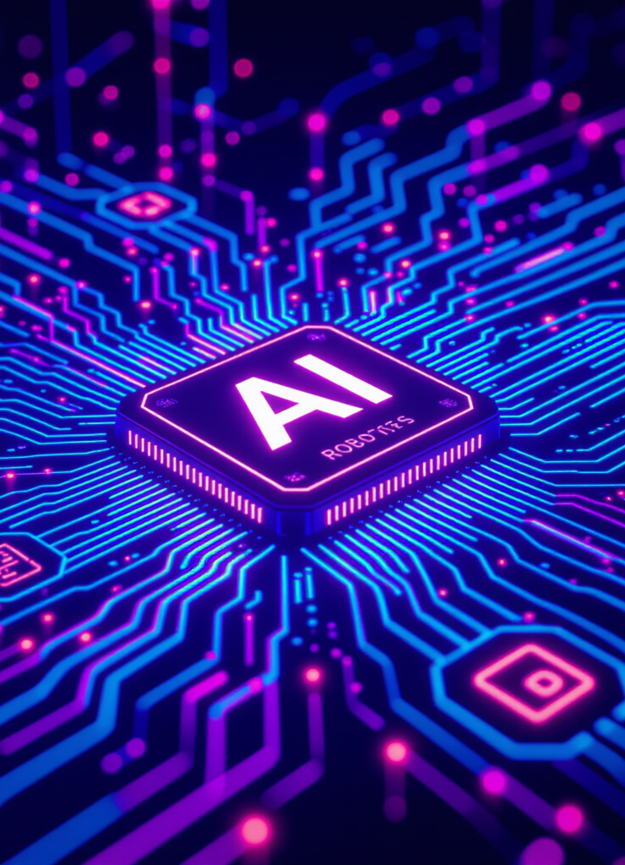
Electric Technocracy – The Electronic Paradise based on the World Succession Deed 1400/98
AI, ASI, Robots, Automation is Taxed
Technology tax pays for Universal Basic Income (UBI)
Humanity is Tax Free
Longevity
Technological Singularity
AI Governance, Direct Digital Democracy
End of scarcity
World of abundance
End of nation states
End of politics/ideologies/conflicts
Paradise on Earth

Slide 2
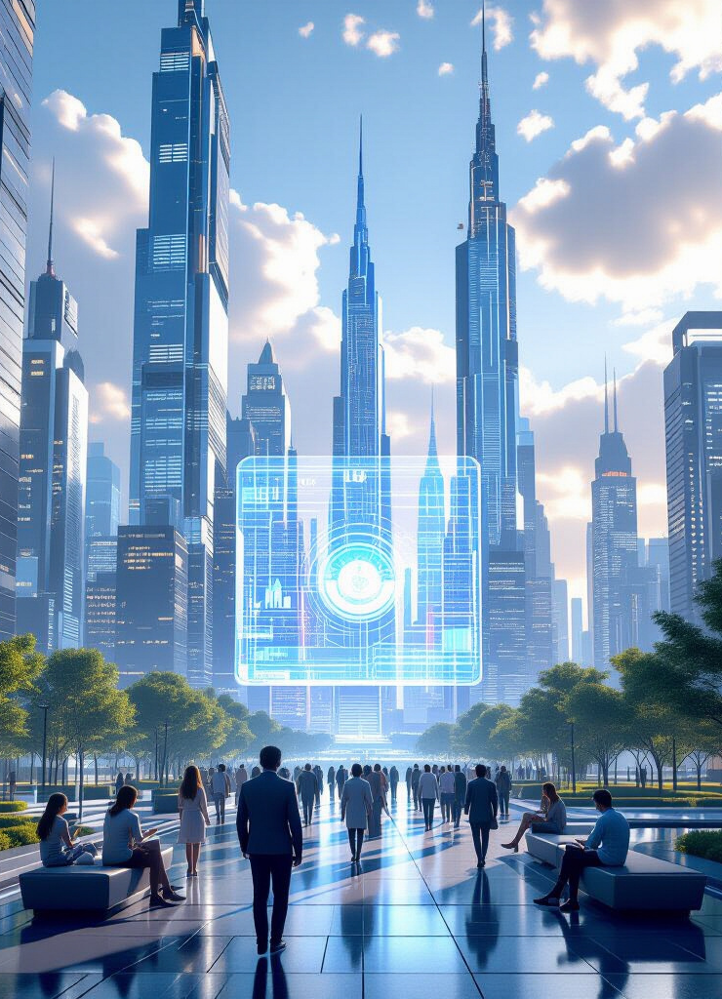
Introduction: Universal Basic Income & the New Civilization
Universal / Unconditional Basic Income (UBI) stands as the critical hinge between our current scarcity-based civilization and a future defined by abundance.
Represents a fundamental shift in how we organize society.
From an economy built on labor and scarcity to one powered by automation and abundance.
This presentation explores the foundations, implications, and potential of this new paradigm.

Slide 3
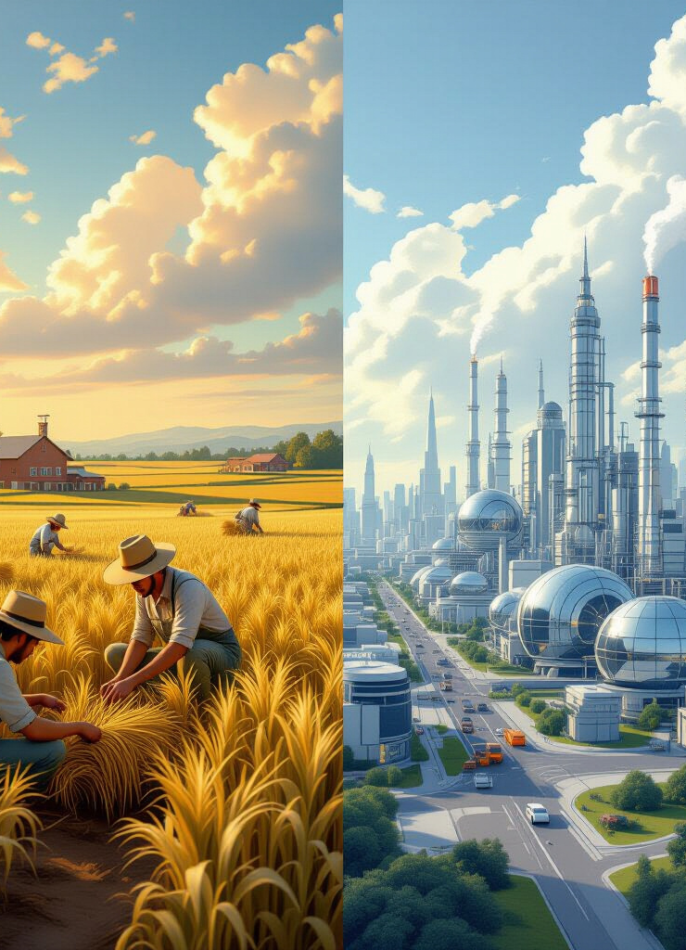
The Old Logic of Scarcity
Agricultural Societies: Survival was intrinsically tied to farming and land ownership.
Limited resources dictated social structures.
Hard labor ensured basic survival.
Industrial Revolution: Labor became the primary economic base.
Capitalism: Taxation of human work was the cornerstone of government revenue.
Scarcity: The underlying driver of morality, conflict, and inequality throughout history.

Slide 4
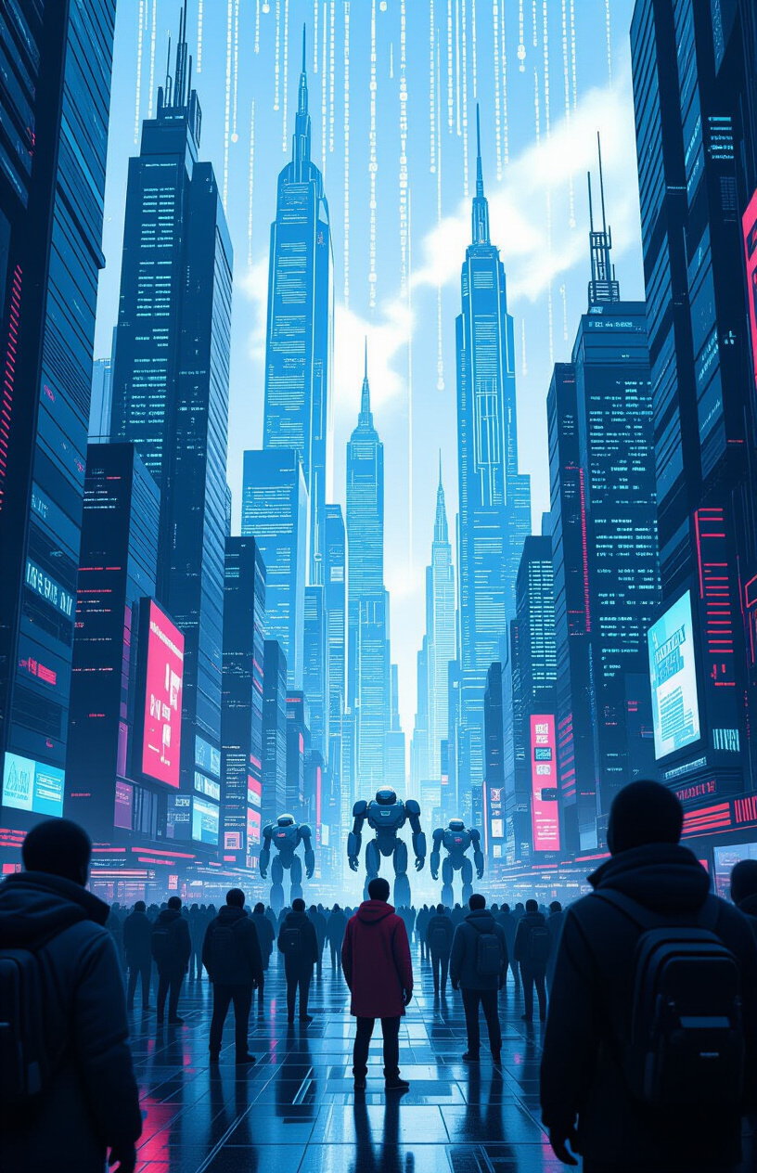
The Collapse of the Old Model
AI/Robotics Displacement: Millions of jobs are being rapidly displaced by AI and robotics across all sectors.
Automation is no longer limited to manual labor.
Cognitive tasks, creative endeavors, and complex problem-solving are increasingly automated.
Examples: Include transport, healthcare, and creativity.
Self-driving vehicles threaten millions of driving jobs.
AI-driven diagnostics and robotic surgery transform healthcare.
AI tools generate art, music, and writing, challenging creative professions.
Exponential Automation: Humans are no longer the main value creators in the economy.
Machines are surpassing human capabilities in many domains.
This shift necessitates a new economic and social model.

Slide 5
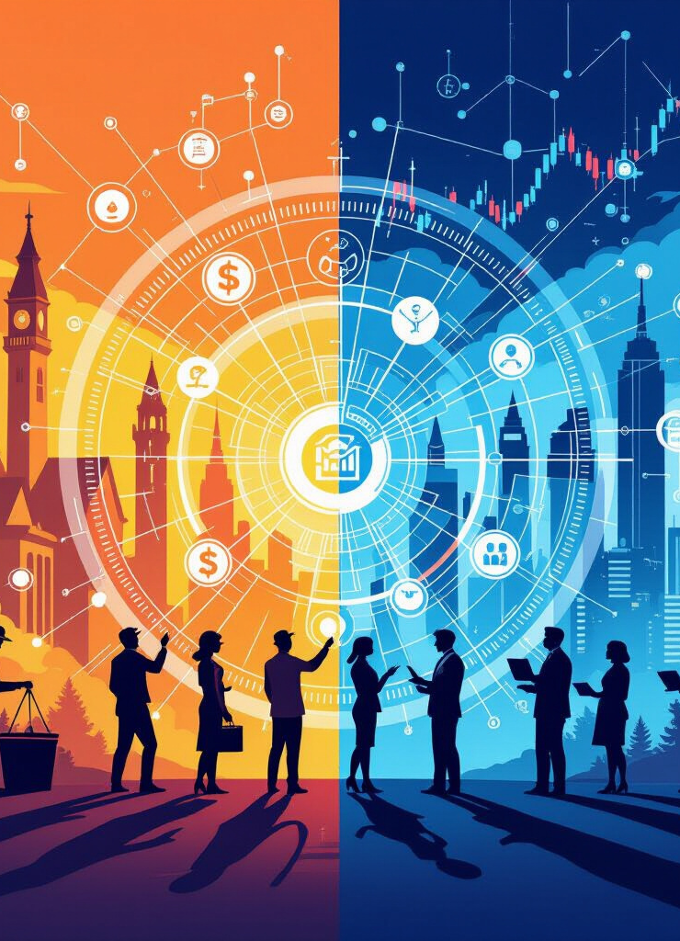
End of Labor-Based Taxation
Historical Context:
Governments historically taxed wages as the primary source of revenue.
Income tax, payroll tax, and other labor-based taxes funded public services.
The Problem: With AI-driven productivity, this tax base is rapidly disappearing.
As machines replace human workers, wage income declines.
Traditional taxation models become unsustainable.
Solution: Humans must become tax-free to incentivize creativity and innovation.
Shifting the tax burden to machines and corporations is essential.
This allows individuals to pursue passions and contribute to society without financial barriers.

Slide 6
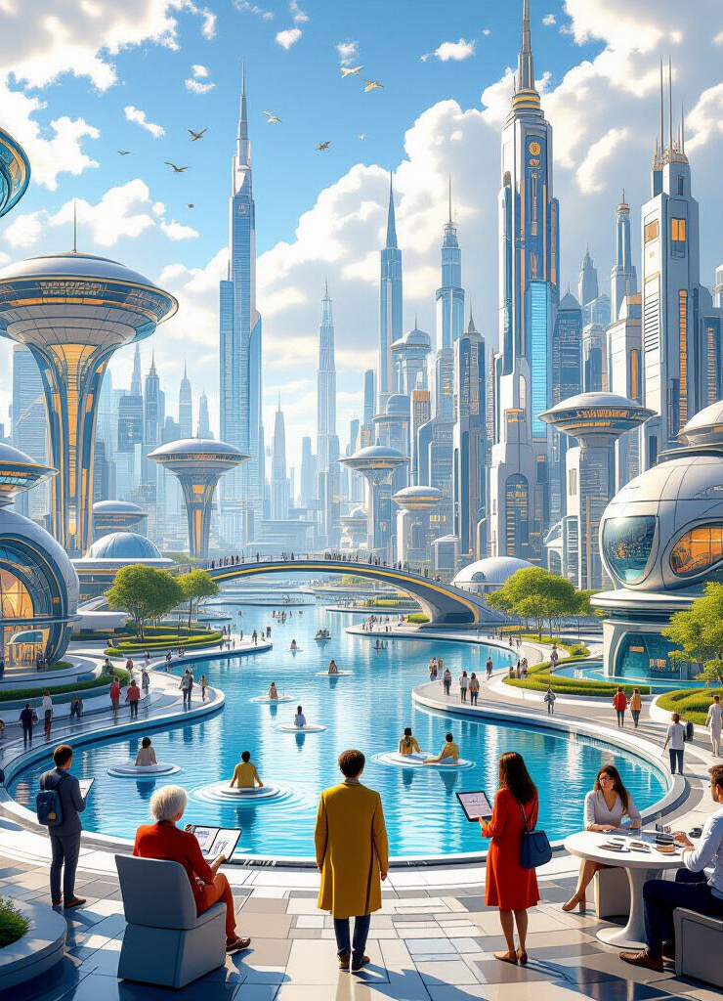
The Birth of the Electric Technocracy
Overview:
Principle 1: Humans Tax-Free: A fundamental right to exist without the burden of taxation.
Incentivizes human potential and innovation.
Fosters a society of creators and thinkers.
Principle 2: Machines and Corporations Finance Society: Taxing the entities that benefit most from automation.
Redirects wealth generated by machines back into society.
Creates a sustainable funding model for public services and UBI.
Principle 3: UBI as Dividend of Abundance: Distributing the fruits of technological progress to all citizens.
Ensures everyone benefits from increased productivity.
Provides a safety net and empowers individuals to pursue their passions.

Slide 7
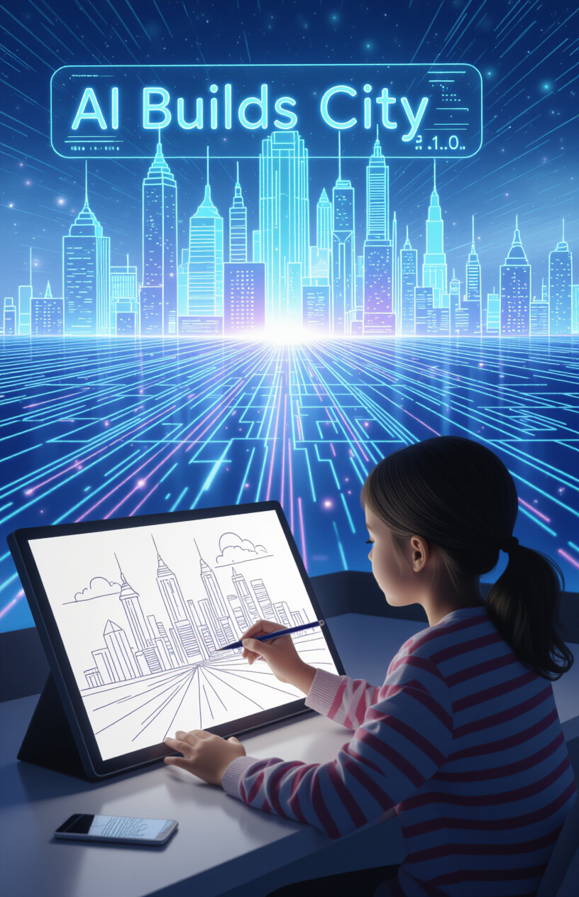
Humanity as Wishmasters
Mythological Metaphor:
Drawing parallels with the Djinn or genie of folklore.
Humans make the wishes, and machines fulfill them.
This metaphor highlights the potential of human creativity and machine execution.
Examples: A child sketches → AI builds a city.
Visualizing a future where imagination shapes reality.
Technology serves as a tool for manifesting human vision.
An artist dreams → robots sculpt vision.
Emphasizing the role of creativity in a technologically advanced society.
Automation enables artists to bring their dreams to life on a grand scale.
A scientist imagines → quantum computers find cure.
Highlighting the potential for scientific breakthroughs.
AI accelerates research and development, leading to rapid advancements in medicine and other fields.

Slide 8
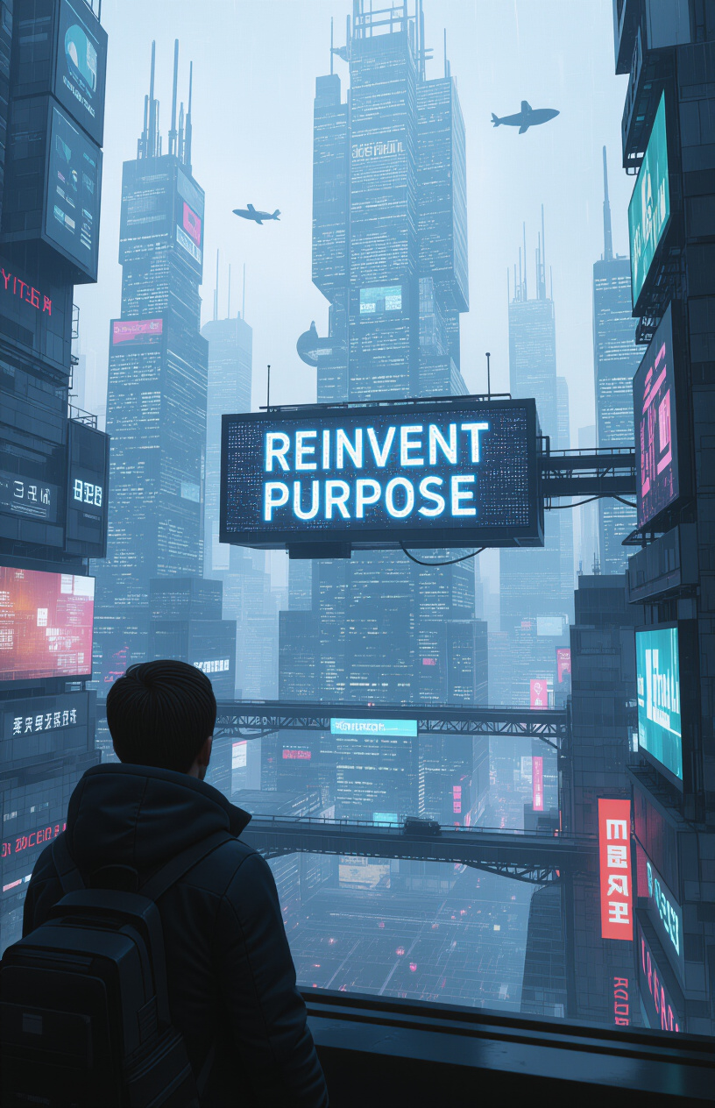
The Psychological Revolution
Work as Identity: Our society traditionally derives identity and meaning from work.
Careers often define social status and self-worth.
The concept of "retirement" implies an end to purpose and contribution.
Machines Doing All Labor: Humans must reinvent their purpose in a world where machines perform all necessary labor.
Free from economic constraints, individuals can explore their passions.
Society must redefine success and fulfillment.
Flourish or Fall: Will humanity flourish with newfound freedom or fall into nihilism without traditional work structures?
This is a critical question for the future of society.
Education, culture, and social support systems must adapt to foster meaning and purpose.

Slide 9

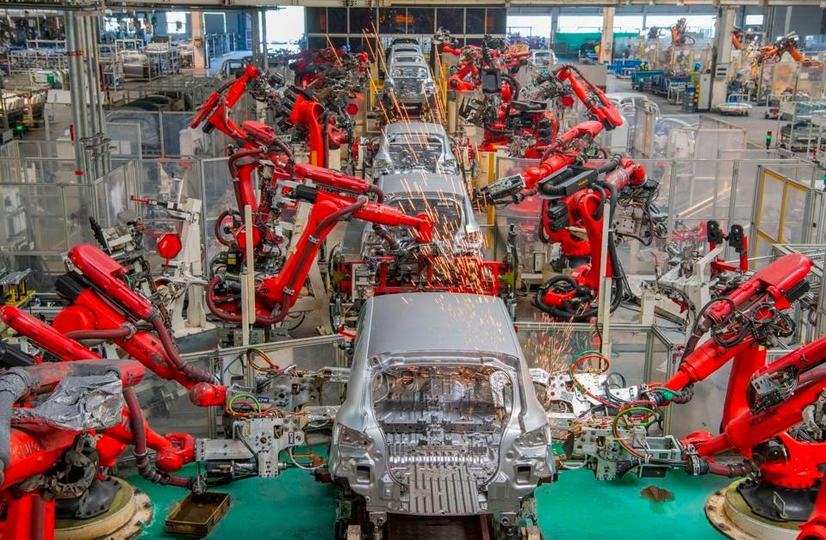
Why Old UBI Models Fail
Redistribution vs Dividend
Electric Technocracy
Traditional redistribution takes from the successful to give to the less fortunate, while a dividend distributes the benefits of increased productivity to everyone. The older UBI models take from successful individuals, which can create disincentives and resentment.
In an Electric Technocracy, machines finance abundance, creating a sustainable and equitable system. Automation generates wealth, which is then distributed through UBI. This approach aligns incentives and fosters collaboration, moving away from the disincentives of older models.

Slide 10



The Abolition of Nation-States
Borders as Obstacles
One World Vision
World Succession Deed 1400/98
Borders hinder the implementation of a global UBI system. National sovereignty creates obstacles to wealth redistribution, and differing tax policies complicate the process.
One world, one law, one income is essential for a truly equitable society. This eliminates national boundaries as barriers to opportunity and ensures access to basic necessities.
The World Succession Deed 1400/98 provides a legal and philosophical basis for global governance, enabling a single, universal system of law and income.

Slide 11
Artificial Superintelligence (ASI) as Global Advisor
Coordinates, Not Rules
ASI acts as a neutral and objective coordinator of global resources, optimizing resource allocation and ensuring all individuals' needs are met.
Open-Source Governance
Open-Source Governance promotes transparent and accessible decision-making, allowing citizens to understand and influence policy decisions, fostering trust and accountability.
Blockchain-Secured Voting
Blockchain-Secured Voting ensures secure and verifiable democratic participation, preventing fraud and allowing for direct citizen input on important issues.

Slide 12
Direct Digital Democracy – End of Politics
Global Participation
Ideologies Obsolete
Citizens Propose Solutions
Citizens directly participate in decision-making processes through technology, enabling widespread engagement and giving every individual a voice in shaping the future.
Ideological divides become less relevant in a data-driven society, with a focus shifting to practical solutions and evidence-based policies, promoting collaboration and consensus.
Anyone can propose solutions to societal challenges, fostering innovation and harnessing the collective intelligence of humanity.

Slide 13
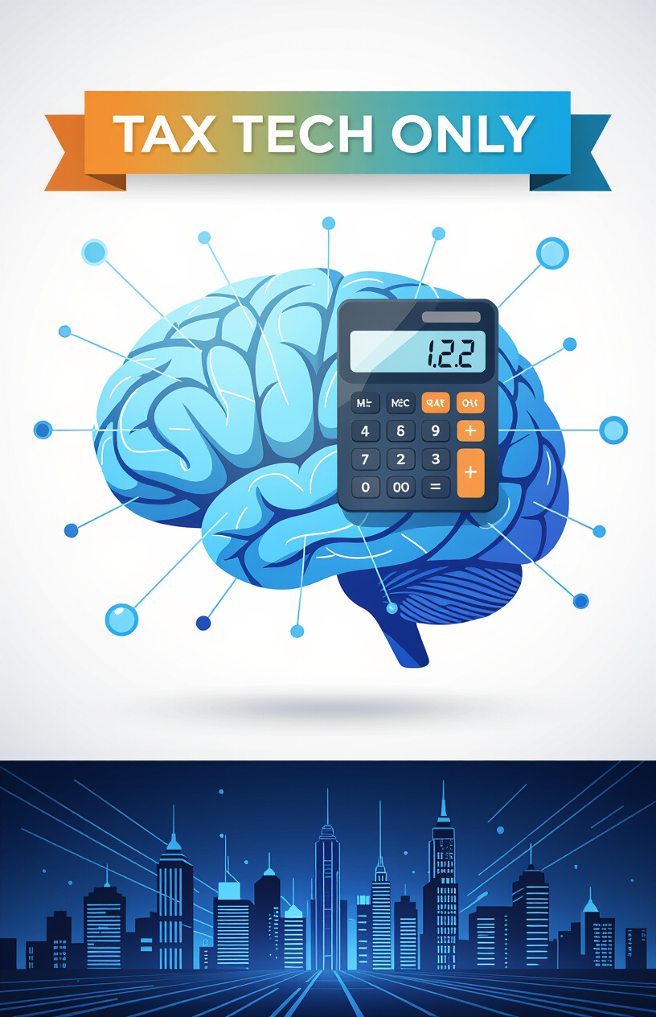
The Tax Revolution: Tax Tech Only
No Tax for Humans:
No income, wealth, or VAT tax for individual humans.
Eliminates the burden of taxation on individuals.
Frees up resources for personal development and innovation.
Corporations and AI Taxed: Corporations and AI are taxed based on their productivity and output.
Ensures that those who benefit most from automation contribute to society.
Creates a sustainable funding model for public services and UBI.

Slide 14
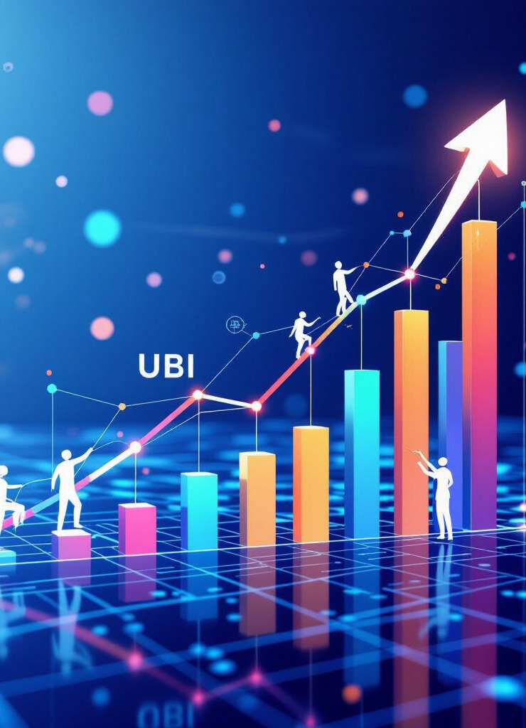
UBI as Dividend, Not Charity
Overview:
Dividend Grows: The UBI dividend grows in proportion to machine productivity.
As machines become more efficient, the dividend increases.
Ensures that everyone benefits from technological progress.
Poverty Abolished: Poverty is permanently abolished as a result of UBI.
Every individual has access to basic necessities and a decent standard of living.
This creates a more just and equitable society.
UBI = Human Right: UBI is recognized as a fundamental human right, not a privilege.
Guarantees economic security for all individuals.
Empowers people to pursue their passions and contribute to society.

Slide 15
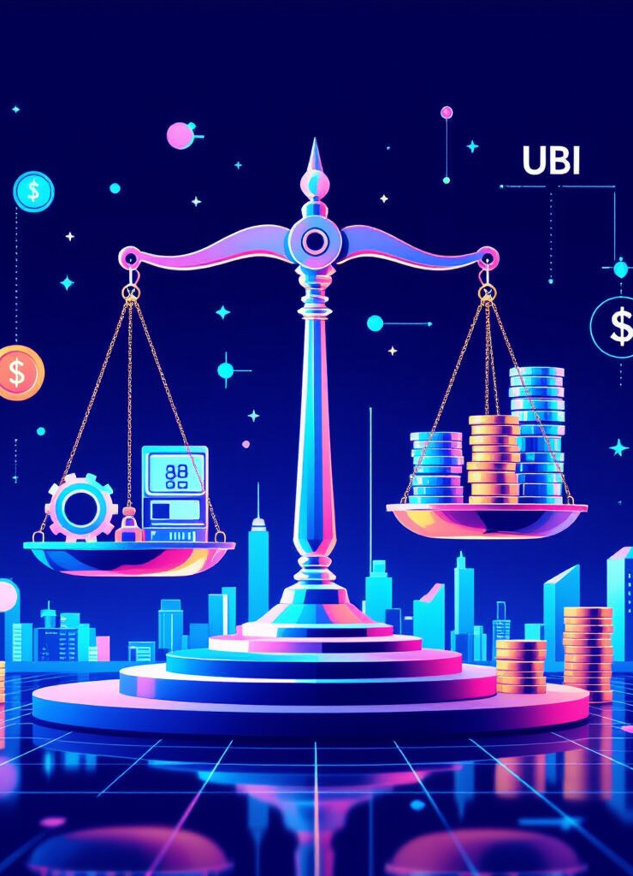
Price Stability Through Machine Productivity
Overview:
UBI Tied to Production: UBI is tied to real production rather than inflationary money printing.
Prevents inflation and maintains price stability.
Ensures that the value of UBI is preserved over time.
Abundance: Abundance ensures stable prices by meeting demand.
Eliminates scarcity and reduces competition for resources.
Creates a more stable and predictable economic environment.

Slide 16
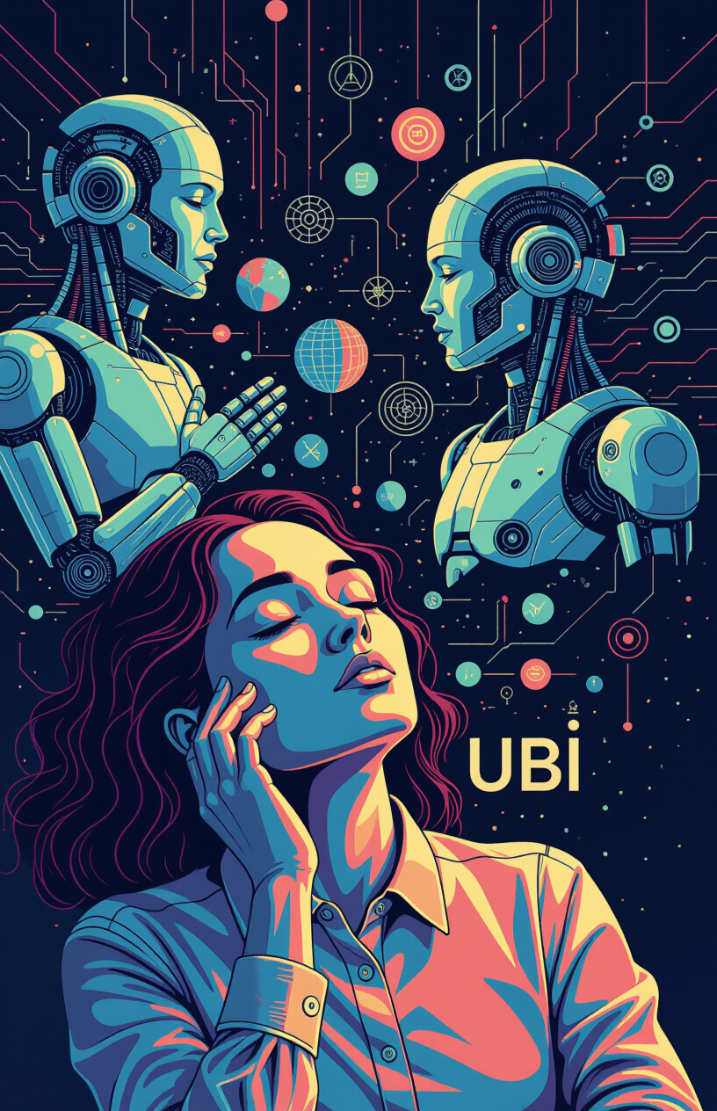
The Djinn Economy – Humans Dream, Machines Fulfill
Overview:
Humans = Dreamers: Humans are freed from labor and can focus on creativity and innovation.
Unleashes human potential and fosters a culture of innovation.
Creates a more vibrant and dynamic society.
Machines = Executors: Machines execute human visions with precision and efficiency.
Automates routine tasks and frees up humans to focus on higher-level thinking.
Maximizes productivity and minimizes waste.
Perfect Division of Labor: A perfect division of labor between humans and machines optimizes economic output.
Creates a harmonious and efficient system of production.
Ensures that everyone benefits from technological progress.

Slide 17
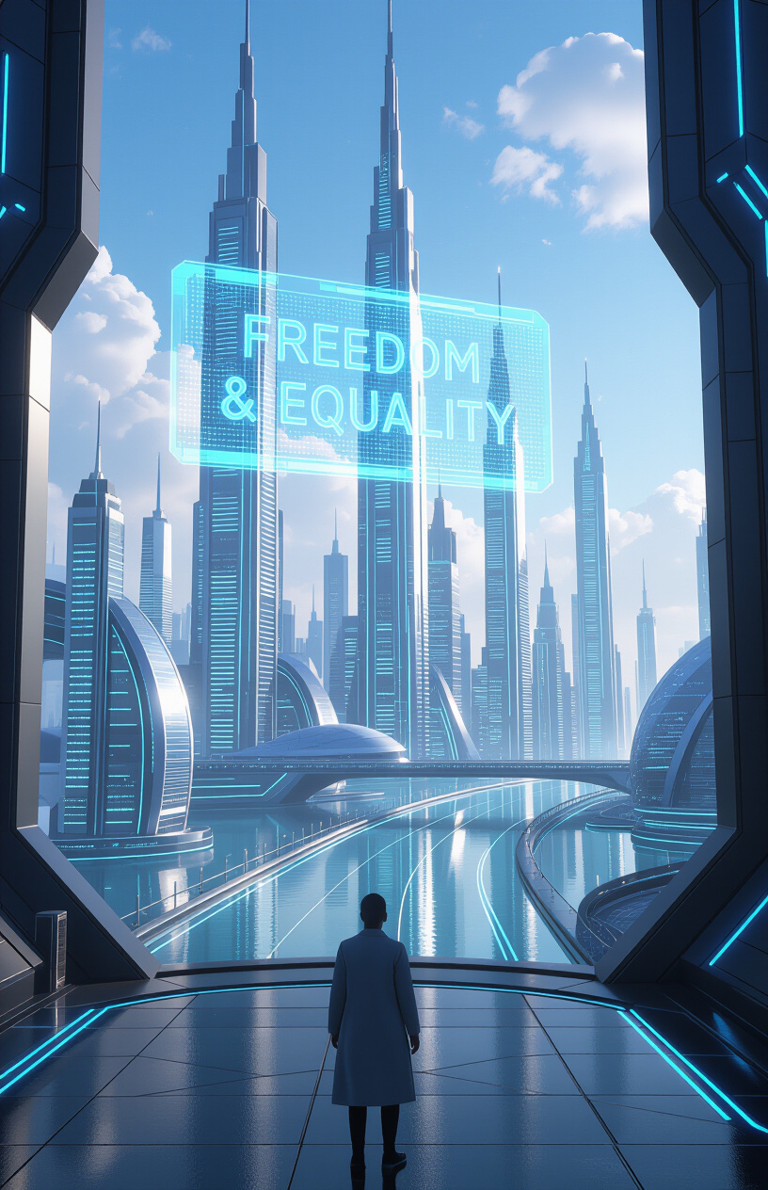
The Moral Superiority of the Electric Technocracy
Freedom and Equality: Freedom and equality are united in the Electric Technocracy.
Individuals are free to pursue their passions without economic constraints.
Everyone has access to basic necessities and a decent standard of living.
Success Rewarded: Success is rewarded based on creativity, innovation, and contribution to society.
Incentivizes individuals to develop their talents and make a positive impact.
Creates a meritocratic system that fosters excellence.
Dependency Eliminated: Dependency on government or charity is eliminated by UBI.
Empowers individuals to take control of their lives and make their own choices.
Creates a more self-reliant and responsible citizenry.

Slide 18
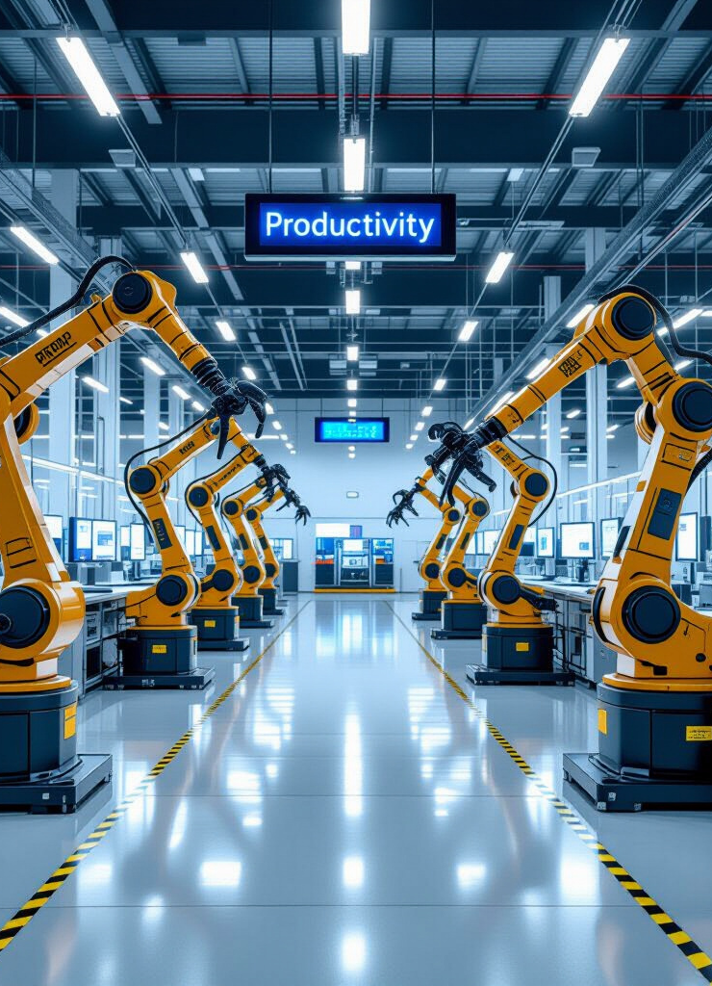
The Hundredfold Leap in Productivity
Workerless Factories: Factories operate without human workers, maximizing efficiency and output.
Reduces labor costs and increases production capacity.
Creates a more sustainable and environmentally friendly system of manufacturing.
Bureaucracy-Free Governments: Governments are streamlined and efficient through automation and AI.
Reduces bureaucracy and corruption.
Improves the delivery of public services.
Corporations Without Managers: Corporations operate without traditional managers, relying on AI and algorithms.
Reduces management overhead and improves decision-making.
Creates a more agile and responsive business environment.

Slide 19
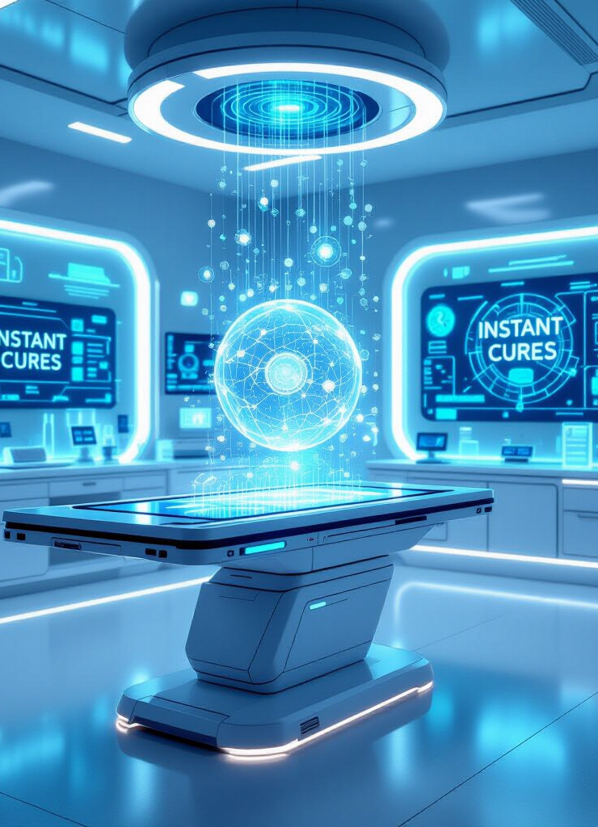
The Technological Singularity
Instant Cures: AI and nanotechnology enable the development of instant cures for diseases.
Eliminates suffering and extends human lifespan.
Reduces healthcare costs and improves quality of life.
Infinite Energy: Fusion power and other advanced technologies provide access to unlimited clean energy.
Eliminates energy scarcity and reduces environmental pollution.
Creates a more sustainable and prosperous future.
Physics and Biology Mysteries Solved: AI accelerates scientific discovery, unlocking the mysteries of physics and biology.
Leads to breakthroughs in medicine, materials science, and other fields.
Transforms our understanding of the universe and our place within it.

Slide 20
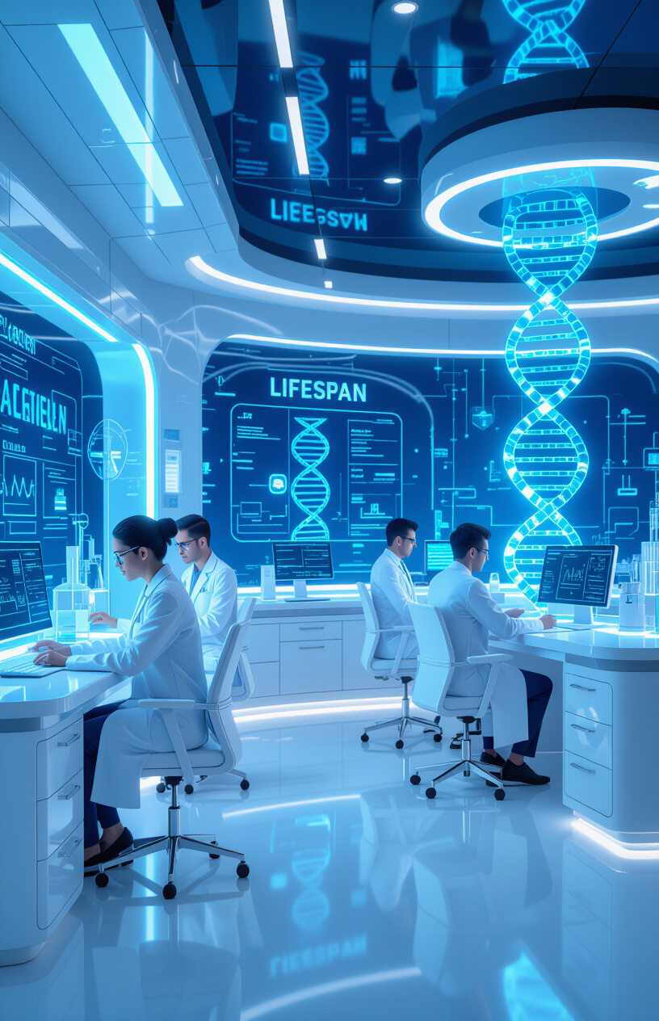
Longevity
Ending Aging as Disease: Treating aging as a disease allows for targeted interventions to slow or reverse the aging process.
Extends healthspan and lifespan significantly.
Reduces the burden of age-related diseases.
AI-Driven Medicine: AI revolutionizes medicine by accelerating research and personalizing treatments.
Improves diagnostic accuracy and treatment effectiveness.
Leads to breakthroughs in regenerative medicine and gene therapy.
Life Extension for All: Life extension technologies are made available to all, not just the elite.
Ensures that everyone can benefit from advances in medicine.
Promotes equality and social justice.

Slide 21
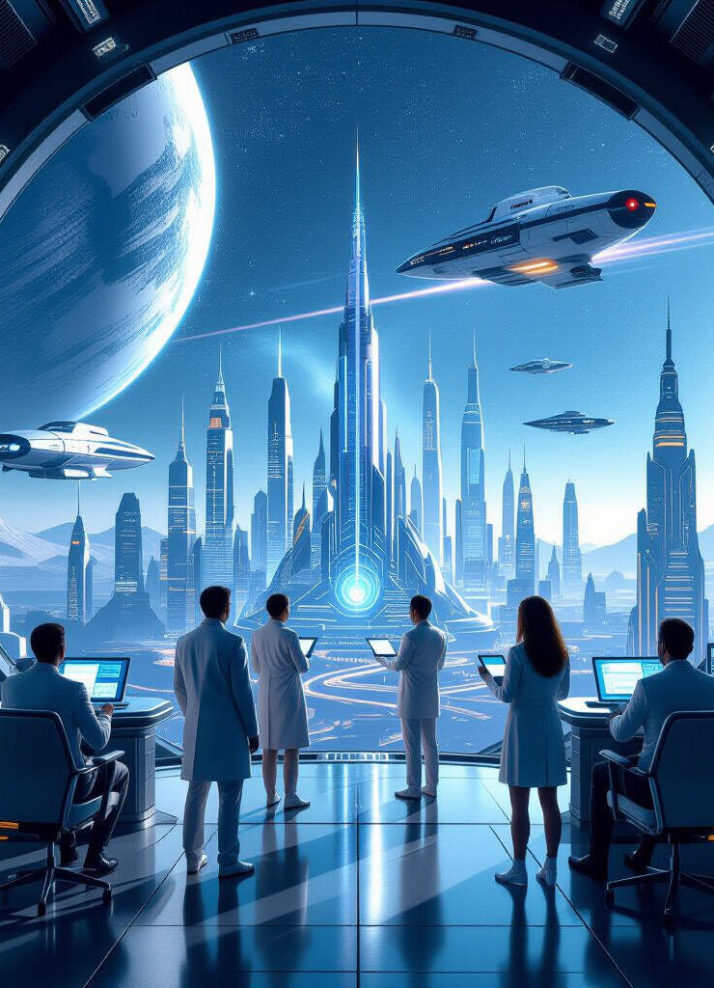
Beyond Immortality – A Civilization That Endures
Reject Elite-Only Immortality: Immortality should be accessible to all, not just a privileged few.
Ensures that the benefits of technological progress are shared equally.
Prevents the creation of a permanent underclass.
Humanity Immortal as Species: Humanity achieves immortality as a species through space exploration and colonization.
Ensures the survival of humanity in the face of existential threats.
Opens up new frontiers for exploration and discovery.

Slide 22
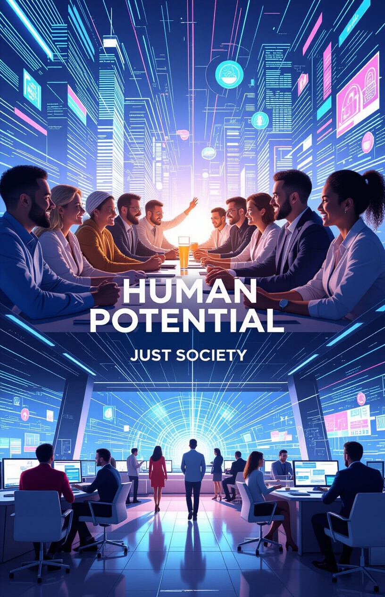
Freedom Without Fear
From Survival to Creation: Humanity transitions from a focus on survival to a focus on creation.
Unleashes human potential and fosters a culture of innovation.
Creates a more vibrant and dynamic society.
No Human Condemned: No human is condemned to poverty or suffering.
Every individual has access to basic necessities and a chance to thrive.
Creates a more just and compassionate society.

Slide 23
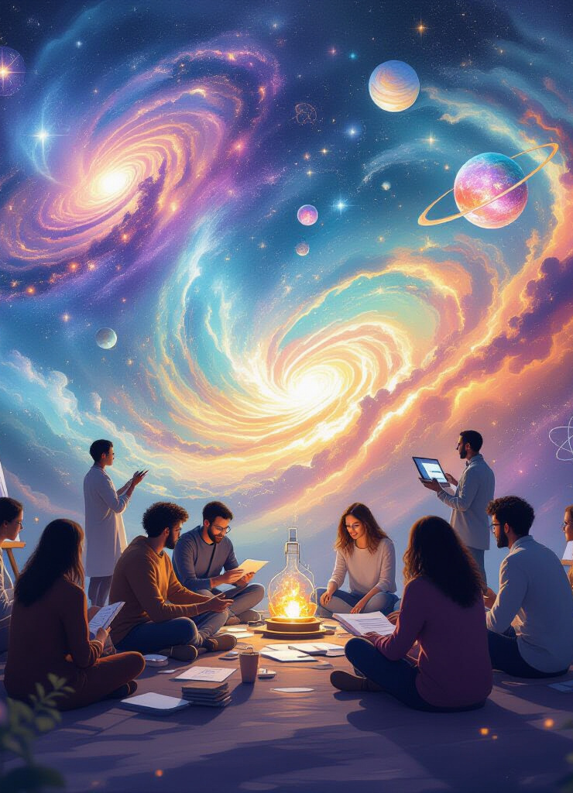
The New Question of Meaning
New Purpose: New purpose emerges: art, science, spirituality become primary focus.
Individuals find meaning and fulfillment in creative pursuits.
Society values innovation, knowledge, and spiritual growth.
New Human Myth: Search for a new human myth that reflects our technological capabilities and aspirations.
Provides a framework for understanding our place in the universe.
Inspires us to strive for a better future.

Slide 24
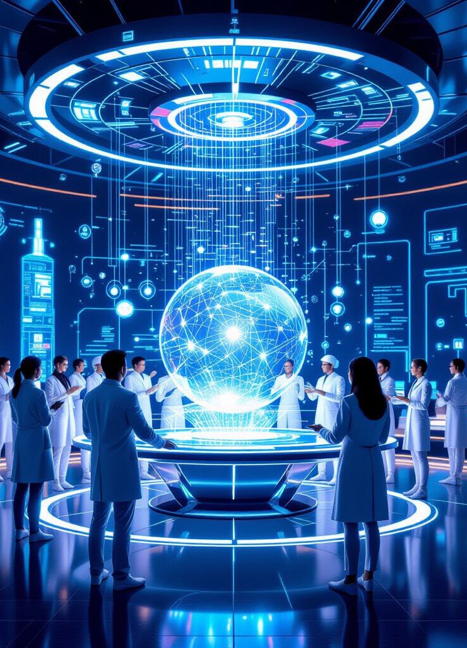
Humanity as Co-Creators
Humans + AI: Humans and AI collaborate on grand works of art, science, and engineering.
Combines human creativity with machine intelligence.
Enables the creation of unprecedented innovations.
Born from Imagination: Cities, arts, and medical cures are born from the power of human imagination.
Highlights the importance of creativity and innovation.
Transforms the world around us.

Slide 25

The Return of Wonder
Awe Returns: Awe returns as disease is eradicated and cosmic exploration begins.
Revives a sense of wonder and curiosity about the universe.
Inspires us to push the boundaries of knowledge and exploration.
Sense of Sacred Wonder: Humanity regains a sense of sacred wonder.
Recognizes the beauty and complexity of the universe.
Fosters a sense of interconnectedness and responsibility.

Slide 26

The Electronic Paradise
Machines Secure Abundance: Machines secure abundance by automating production and optimizing resource allocation.
Eliminates scarcity and ensures that everyone has their needs met.
Creates a more stable and prosperous society.Humans Provide Imagination: Humans provide imagination by creating art, science, and new technologies.
Drives innovation and fosters a culture of creativity.
Transforms the world around us.
ASI Manifests Dreams: ASI manifests dreams by bringing human visions to life on a grand scale.
Enables the creation of unprecedented innovations.
Transforms the world around us.
Paradise Not Utopia: Paradise is not a static utopia, but a dynamic rebirth of civilization.
Recognizes the importance of continuous growth and improvement.
Inspires us to strive for a better future.

Slide 27

Infographic Mega Summary
Circular Flow:
Visual representation of the transition: Scarcity → Collapse → Electric Technocracy → Singularity → Longevity → Paradise.
Illustrates the interconnectedness of these stages.
Provides a holistic view of the transformation.Pillars: Key pillars of the Electric Technocracy: ASI, UBI Dividend, Tax Tech Only, Global Governance.
Highlights the essential components of this new paradigm.
Emphasizes the importance of each element.
Final Choice: The ultimate choice facing humanity: Dystopia vs Paradise.
Underscores the importance of making the right decisions.
Inspires us to work towards a better future.

Slide 28
👓 find out more about it:
📚 Universal / Unconditional Basic Income (UBI)
http://ubi.gt.tc/
🖼️ UBI Storybook: Wishmaster and the Paradise of Machines: https://g.co/gemini/share/4a457895642b
🌐 Website - WSD - World Succession Deed 1400/98
http://world.rf.gd
🌐 Website - Electric Technocracy
http://ep.ct.ws
📘 Read the eBooks & Download free PDF:
http://4u.free.nf
🎥 YouTube Channel
http://videos.xo.je
🎙️ Podcast Show
http://nwo.likesyou.org
🚀 Start-Page WSD & Electric Paradise
http://paradise.gt.tc
🗣️ Join the NotebookLM Chat WSD:
http://chat-wsd.rf.gd
🗣️ Join the NotebookLM Chat Electronic Paradise:
http://chat-et.rf.gd
🗣️ Join the NotebookLM Chat Nation Building:
http://chat-kb.rf.gd
http://micro.page.gd
🖼️ Micronation Storybook:
The Slactivist's Guide to Saving a Forest (By Declaring It a Country
https://g.co/gemini/share/9fe07106afff
📜 The Buyer's Memoir:
A Journey to Unwitting Sovereignty 📜
http://ab.page.gd
🌚 Blacksite Blog:
http://blacksite.iblogger.org
🎧 Cassandra Cries - Icecold AI Music vs WWIII on SoundCloud
http://listen.free.nf
🪖 This is anti-war music
http://music.page.gd
🎗️ Support our Mission:
http://donate.gt.tc
🛍️ Support Shop:
http://nwo.page.gd
🛒 Support Store:
http://merch.page.gd

